Slide 1
“DARE TO DREAM”
Great Britain Ice Hockey

Slide 2
REACHING THE OLYMPICS
Feb 2020
Pre-Olympic Qualification (Group J)
August 2020
Pre-Olympic Qualification (Group D)
Feb 2022
Olympic Games

Slide 3
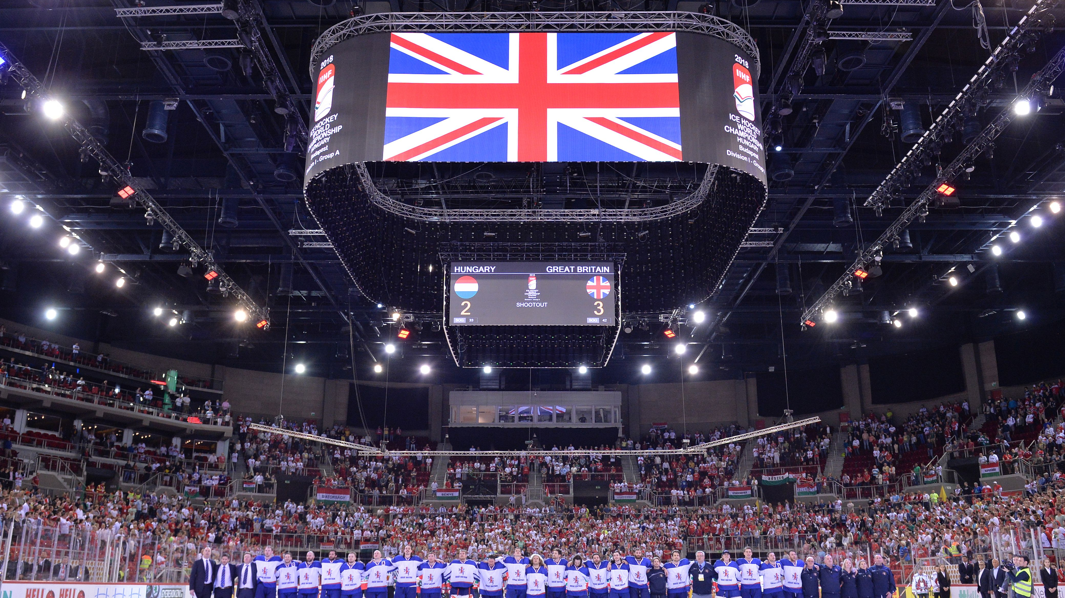

Slide 4
MEET THE TEAM – OLLIE BETTERIDGE

Slide 5
TEAM GB CHARACTERISTICS
Resilience
Determination
Hard Work
Team Work
Sportsmanship

Slide 6
COMPETING TEAMS - NOTTINGHAM
Country
Country
Country
Country
GREAT BRITAIN
HUNGARY
ESTONIA
ROMANIA
Population
Population
Population
Population
64,769,452
9,850,845
1,251,581
21,529,967
IIHF Member Since
IIHF Member Since
IIHF Member Since
IIHF Member Since
1908
1927
1935
1924
No. of Ice Rinks
No. of Ice Rinks
No. of Ice Rinks
No. of Ice Rinks
68
41
12
8
World Ranking
World Ranking
World Ranking
World Ranking
20
21
26
27

Slide 7
ACTIVITIES FOR YOU…
PRE-OLYMPIC QUALIFICATION
IS COMING TO NOTTINGHAM

Slide 8
COUNTRY PROFILE
Research one of the countries competing in Nottingham and complete a country profile

Slide 9
SHOW YOUR SUPPORT
@TeamGBicehockey
Write a message of support to the Team GB Ice Hockey Players
#DARETODREAM

Slide 10
BUILD YOUR TEAM
Develop your own class of hockey players, each holding a key characteristic to be successful

Slide 11
STREET HOCKEY LESSON PLAN
Learn the basics and test your skills against your class mates

